Slide 1
Models in Mobility: Partnerships, Engagement, and Service Learning in the Pursuit of Intercultural Competency

Slide 2
PANEL INTRODUCTIONS
Panel Host and Moderator:
Dale LaFleur, Director of Institutional Relations
Office of Global Initiatives
Harmony DeFazio
Director of Study Abroad and Student Exchange, Office of Global Initiatives
Dr. Melody Buckner
Director of Digital Learning Initiatives and Online Education
Ash Scheder Black
Director of Technology
Office of Global Initiatives
Dr. Tom Wilson
Associate Professor of Practice
Soil, Water and Environmental Science
Notes:
What to do with the header?

Slide 3
QUESTIONS FOR THE AUDIENCE
What are your existing challenges related to assessing intercultural competency development?
What are you doing already to address these challenges?
What outcomes would you like at the end of this session?

Slide 4
INTERNATIONALIZATION OF HIGHER EDUCATION IN UNITED STATES
Notes:
What to do with the header?

Slide 5
INTERNATIONALIZATION OF HIGHER EDUCATION IN UNITED STATES
Internationalization, defined as “the process of integrating an international, intercultural or global dimension into the purpose, functions or delivery of post-secondary education” (Knight, 2003, p. 2).
Impact of internationalization has evolved over time and directly influences the behavior of higher education institutions globally
November 2012, the U.S. Department of Education (DoED) released it’s first-ever five-year international strategy, Succeeding Globally Through International Education and Engagement.

Slide 6
INTERNATIONALIZATION OF HIGHER EDUCATION IN UNITED STATES
This document outlines two national strategic goals: 1) strengthening U.S. education and 2) advancing the nation’s international priority (DoED, 2012).
The four main priorities are to provide:
a world-class education for all students
global competencies for all students
international benchmarking and applying lessons learned from other countries
education diplomacy and engagement with other countries

Slide 7
INTERNATIONALIZATION OF HIGHER EDUCATION IN UNITED STATES
Other recent national initiatives supporting the internationalization of higher education in the U.S.:
100,000 Strong Initiatives in China and the Americas launched in 2010 and 2011
Obama-Singh 21st Century Knowledge Initiative launched in 2009
U.S.-Russia University Partnership Program launched in 2015
DoED also has bilateral agreements with eleven countries around the world that focus on language learning, policy development, and improving the quality of education globally.

Slide 8
INTERNATIONALIZATION OF HIGHER EDUCATION WORLDWIDE
Academic
Expanding higher education capacity
Improving higher education quality
Prestige and rankings
Knowledge creation and advancement
Economic
Short-term economic gain
Workforce development
Long-term national economic development
WHY?
Political
Public diplomacy and “soft power”
National Security
International development
Social/Cultural
Addressing global problems
Global citizenship
Mutual understanding
(ACE Report, 2015)

Slide 9
INTERNATIONALIZATION OF HIGHER EDUCATION IN UNITED STATES
How has this impacted higher education institutions in the U.S.?
Introduction of new program models and partners
Need for assessment of programs, learning, and competencies
Use of technology
Four Models introduced to you will focus on these three areas.

Slide 10
ASSESSMENT CHALLENGES IN STUDY ABROAD
Harmony DeFazio
Executive Director, Global Mobility Lab
Director, Study Abroad and Student Exchange
Office of Global Initiatives

Slide 11
The UA Context: 100% Engagement
100% Engagement initiative is a central part of the UA strategic plan
Students will have the opportunity to engage in integrating and applying their knowledge through real-world experiential learning
Credit-bearing or non-credit experiences that help students develop professional and personal skills (appears on transcript)
Strong reflection component and focus on learning outcomes (apply, reflect, articulate)

Slide 12
Emphasis on Student Learning Outcomes in Study Abroad
Move beyond the anecdotal “Study abroad changed my life!”
Articulate the value of global experiences
Align with 100% Engagement
Notes:
Articulate the value of global experiences
Study Abroad Professionals: Administration, government, funding
Students: Potential employers, friends, family

Slide 13
Study Abroad & Student Exchange: Where we are now
Program evaluations
How did you like the program vs. what did you learn
Assessment of learning outcomes done by faculty
Mostly focused on course content
No assessment of learning outcomes on non-faculty-led programs
No centralized assessment of overarching learning outcomes
Program vs. course(s)
Study abroad as an engagement experience

Slide 14
Study Abroad & Student Exchange: Moving Forward
Developing an assessment plan that includes
Teacher Course Evaluation (TCE) for study abroad
Program evaluation
Overarching learning outcomes
Assessing a course vs. assessing a program
Collaborating with academic units and faculty
Building programs “correctly” from the ground up
Notes:
Developing a plan that includes
Teacher Course Evaluation (TCE) for study abroad
Program evaluation
Student learning outcomes
Assessing a course vs. assessing a program
Building programs “correctly” from the ground up
Including assessment plan in all new programs
Collaborating with academic units and faculty
Be proactive about course development
Building a network of faculty collaborators

Slide 15
Challenges
In-house assessment and global competency expertise
Convincing the experts to play with us
Not an academic unit
Finding a home for courses
100% Engagement
for-credit vs. non-credit, incorporating reflection
Faculty buy-in
Study abroad initiative vs. faculty initiative
Retrofitting existing programs
Notes:
In-house assessment and global competency expertise
Faculty collaboration on course design and assessment plan
Not academic unit
Finding an academic home for the course
100% Engagement
for-credit vs. non-credit, incorporating reflection
Faculty buy-in
Study abroad initiative vs. faculty initiative
Retrofitting existing programs

Slide 16
MODEL #1 The Global Context of Service Learning: Cocoa in Mexico
Summer service learning program
Communities throughout Tabasco, Mexico
Binational US and MX student teams
Community-identified projects
Multi-disciplinary (selected by communities)
Farm to table concept

Slide 17
Addressing the Challenges: Focus on collaboration
Course concept developed by Study Abroad & Student Exchange
Designed to be used across service learning programs
Content developed in close consultation with faculty
Intercultural concepts woven throughout
Assessment by faculty AND participating communities
Strong reflection component
Curriculum integration in collaboration with academic units
Work with departments across campus to host the course
Get the course approved as general education requirement
For-credit 100% engagement experience

Slide 18
INSTRUCTIONAL DESIGN
Dr. Melody Buckner
Director of Digital Learning Initiatives and Online Education

Slide 19
INSTRUCTIONAL DESIGN
How to apply instructional design in a study abroad setting?
Learning Objectives/Outcomes
Activities to assist students in the learning
Assessment to know that learning has happened
Application into real life

Slide 20
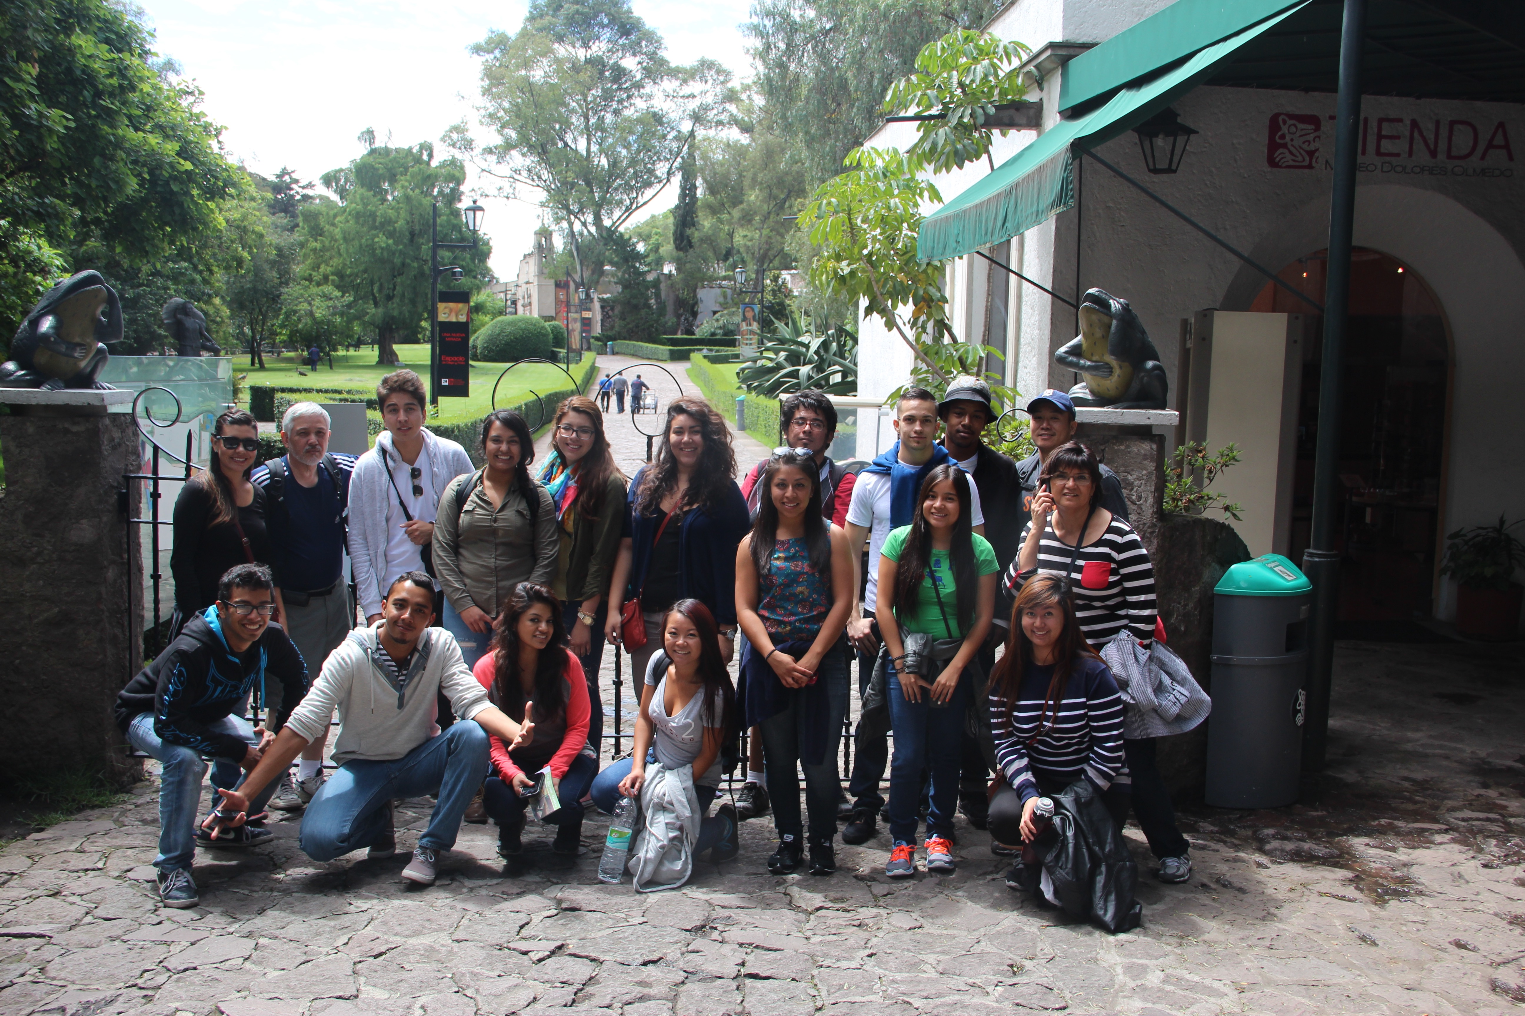
MODEL #2: DIGITAL STORYTELLING AS AN ASSESSMENT TOOL
What are the benefits of using digital storytelling as an assessment tool in study abroad programs?
Engagement
Experiential
Reflection
Digital Literacy Skills
Project Based Assessment
www.melodybuckner.com

Slide 21
Tech.Global Study Abroad. Make the World.
Ash Scheder Black
Director of Technology
Office of Global Initiatives

Slide 22
MODEL #3 Tech.Global : The Inspiration
A new UA study abroad/work opportunity in response to multiple trends impacting Higher Education
“Employers of all kinds - business, government, and not-for-profit - are on the lookout for technically trained personnel who have honed their transnational interpersonal-interaction skills.
Nevertheless, most professional-education programs remain deficient in preparing graduates with the skills needed to work in teams of specialists from many countries and fields” (Shaw and Kim 2008).
Entrepreneurship
Alignment with Industry
Internationalization
Accountability & Assessment

Slide 23
Tech.Global: The Inspiration
A 100% Engagement Opportunity where Professional Development meets Intercultural Competency
A job
A for-credit Intercultural Competency course
A Study Abroad program
A student reflection/portfolio integrating all three components

Slide 24
Tech.Global: The Inspiration
A highly successful proof-of-concept
An International Office with an ambitious technology agenda
A need for programmers and UI specialists
Prior technology mentoring experience in an international environment
Access to a population of eager, smart and internationally focused student workers

Slide 25
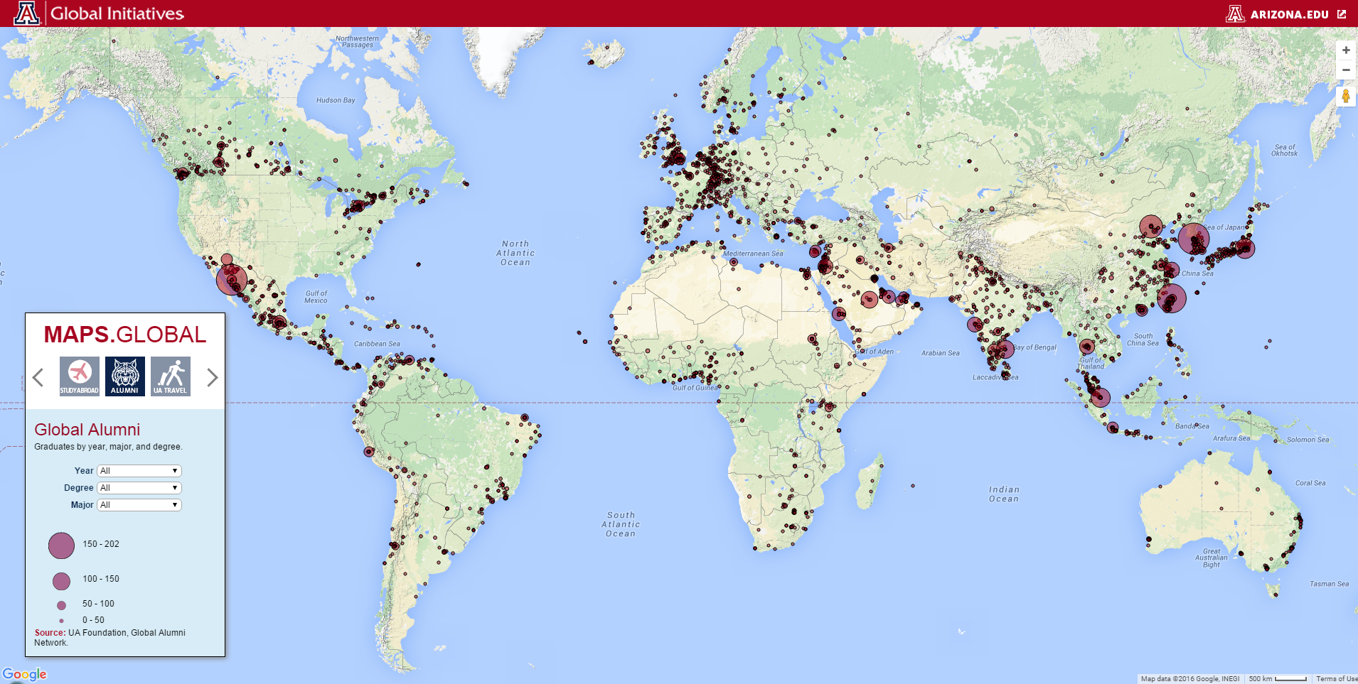
Tech.Global: The Inspiration
A highly successful proof-of-concept
An International Office with an ambitious technology agenda
Ability to recruit internationally focused student workers
Prior technology mentoring experience in an international environment

Slide 26
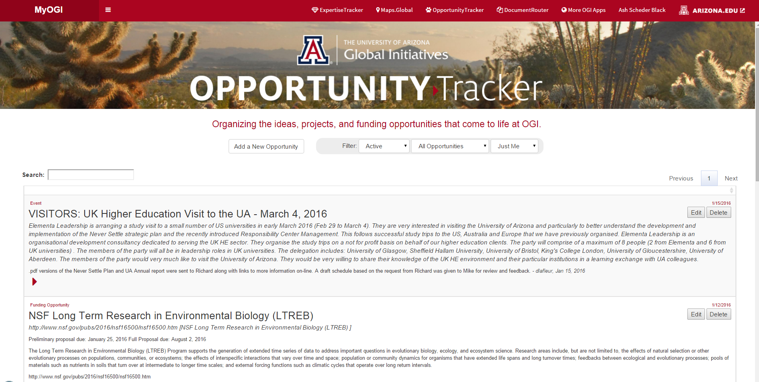
Tech.Global: The Inspiration
A highly successful proof-of-concept
An International Office with an ambitious technology agenda
Ability to recruit internationally focused student workers
Prior technology mentoring experience in an international environment

Slide 27
Tech.Global: The Inspiration
“One of the key challenges/rewards of this position was working on some large full-scale .NET applications. Initially it was quite challenging for me to grasp some of the new complexities and languages (C#, SQL, and JQuery) that I was getting exposed to. Despite that, I found myself getting more and more fascinated by programming, and so during the coming months I kept teaching myself the new tricks and concepts while also seeking guidance from my manager.
Since then I have learned that it doesn't matter what language or tools you are using; programming is just a realization of the thought process of the programmer. From my point of view it doesn't matter what you know, what matters more is how you think, and that's the part that fascinates me the most.”
– Imtiaz Sayed, Web & Data Applications Developer, Tech.Global.

Slide 28
Tech.Global: The Paradigm
Study Abroad. Make the World.
Positivist
Relativist
Constructivist
“The most general practical goal of intercultural learning is to overcome ethnocentrism and to enable successful communication in a multicultural environment.
The constructivist paradigm allows us to see that ethnocentrism is simply the inability to experience reality differently than we were originally taught” (Vande Berg, Paige, Lou, 2012).

Slide 29
Tech.Global: The Paradigm
Dimensions of Intercultural Learning?
Industry
Host Culture
Geek
Normie
Home Culture
Academia

Slide 30
Tech.Global: The Paradigm
Is “technology” itself a “culture”, and if so, can that be leveraged to facilitate multi-dimensional intercultural learning?
An uncontested driver and enabler of internationalization
Can unite learners by passion
New “language learning” like Python vs JavaScript emphasizes common language of mathematics, logic, and whoah.
Arguably a unique sub-culture with its own idioms, norms, and means of distributing itself (viral propagation, memes) – the App- or Device-centric world-view.

Slide 31
Tech.Global: The Program
Tech.Global
Agile Software Development Team
One Year
UA Study Abroad Students
UA International Students
HTML5, JavaScript, CSS
C#, OOP
SQL + Visualization
UI/UX
Unity, VR
PHP, BootStrap, etc…
HUMS 372 + Study Abroad Experience
Agile development methodology
Collaboration skills
Effective Googling
Web and SM publishing skills
Professional portfolio
Applications Development
Student Reflection

Slide 32
Tech.Global: The Outcomes
Immersion in the Agile development process
Iteration based learning with emphasis on short term goals and many, many opportunities to do better next time
Unites the end-user and the developer mentalities during the build
Failure is OK, and expected.
Creativity, collaboration, and rapid delivery are emphasized
Best practice as you go…

Slide 33
Tech.Global: The Outcomes
Personal and Career Transformation both home and away
Major personal achievement and recognition via 100% Engagement Credit
Multi-dimensional Intercultural competency – the ability to recognize and perhaps navigate different world views be they geographic, generational, professional, technological, etc…
Earned income in a spirited and professional learning environment.
Demonstrable command of in-demand Web and Data Applications skills
Professional portfolio

Slide 34
Tech.Global: The Assessment
Professional Development: Students are mentored daily and receive “level-up” assessments of performance and capabilities at 256, 512, and 1024 hour thresholds
Intercultural Competency: Students complete 3.0 credit HUMS 372 coursework with formal evaluation by University professor(s).
Student Reflection Component: Formally reviewed by a panel consisting of a technology mentor, an intercultural competency mentor, and an Instructional Design expert.
Reflection component is also showcased to incoming undergraduates and international students, to really put the pressure on.

Slide 35
Tech.Global: The Assessment
Integrated professional and intercultural competency assessment
Industry ready technical portfolio
Applications hosted for 5 years (subject to terms of use)
Systemic evaluation of student’s contributions and professional skills
Long-term (1 year, 3 year, 5 year) follow-up correlating student post-matriculation occupational attainment and satisfaction.

Slide 36
FIELD WORK STUDY ABROAD FACULTY – LED PROGRAM
Dr. Tom Wilson
Associate Professor of Practice
Soil, Water and Environmental Science

Slide 37
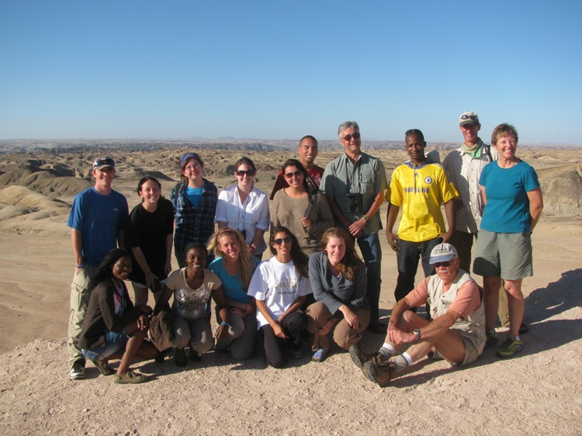
MODEL #4: ASSESSMENT OF FIELD WORK
Conservation Biology in Namibia
A six week program established in 2008 for undergraduates and graduates. Each year we take 8 – 12 students from a variety of majors and backgrounds.

Slide 38
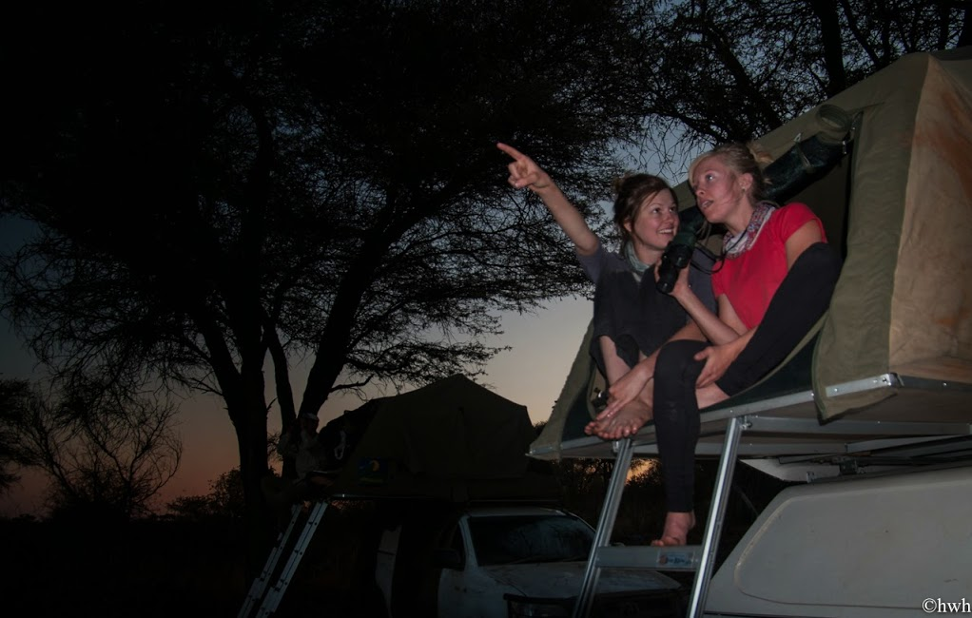
MODEL #4: ASSESSMENT OF FIELD WORK
Course Format:
Visit conservation organizations in central and northern Namibia
Students develop a research project involving field observations of a subject of their choice
Camp for the duration of the class

Slide 39
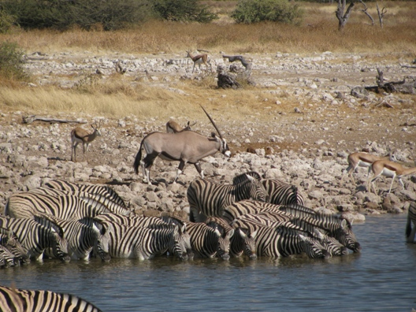
MODEL #4: ASSESSMENT OF FIELD WORK
Course Format:
Promotes awareness of other cultures
Involves direct interaction with local people
Develops critical thinking skills
Emphasizes experiential learning

Slide 40
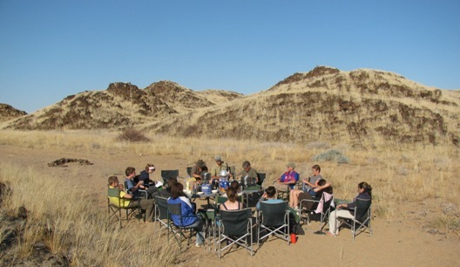
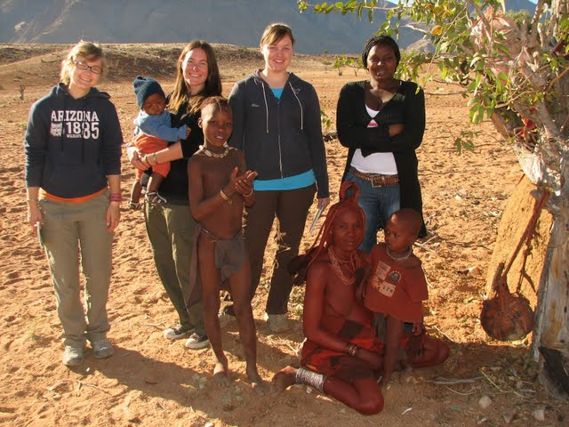
MODEL #4: ASSESSMENT OF FIELD WORK
Assessment:
Field notebook
Data collection, locations and description
Student audio log
Daily description of activities
End of class feedback session
What students liked
What students suggest for improvement

Slide 41
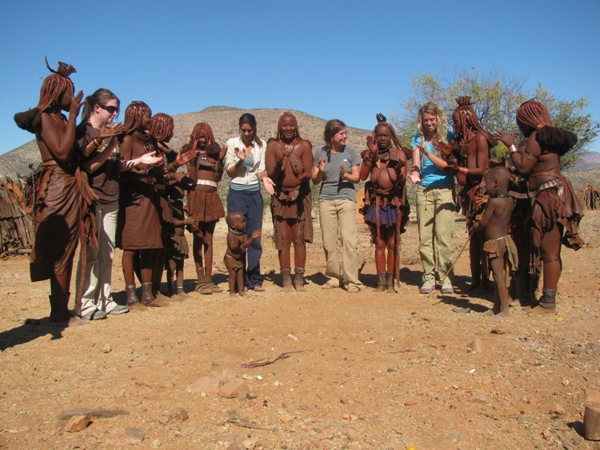

Slide 42
Discussion

Slide 43
Contact information
Melody Buckner
mbuckner@email.arizona.edu
Harmony DeFazio
defazioh@email.arizona.edu
Dale LaFleur
dlafleur@email.arizona.edu
Ash Scheder Black
ashblack@email.arizona.edu
Tom Wilson
twilson@cals.arizona.edu

