Slide 1
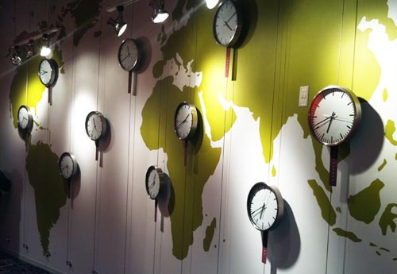
Space Matters:
Creating an Environment for
Cultural Inclusivity
introduction
physical
virtual
blended
By Melody Buckner
For LRC 595E – The Anthropology of Education
Fall 2010
conclusion

Slide 2
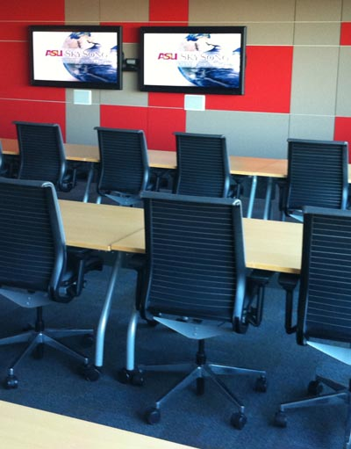
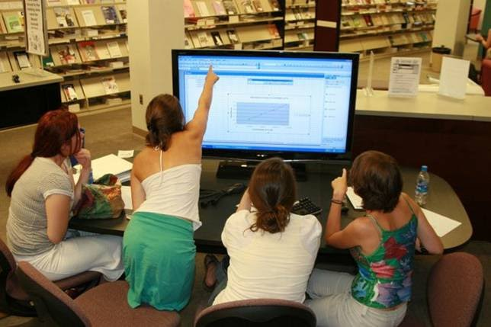
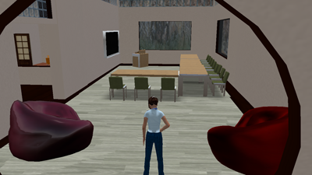
Introduction
Physical
introduction
Learning Spaces come in
several variation
physical
virtual
blended
Blended
Virtual
conclusion

Slide 3
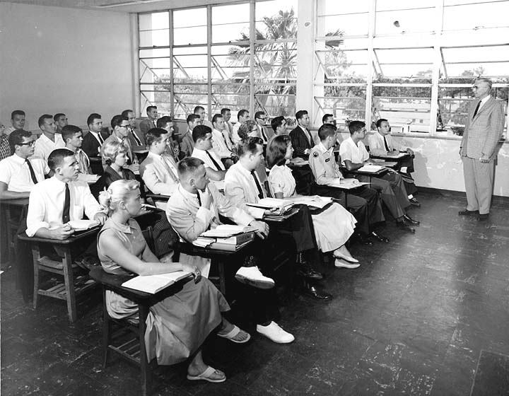
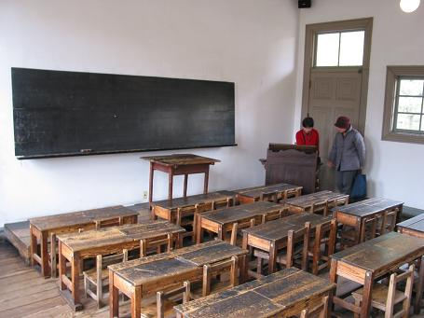
Physical Spaces
introduction
Describe a few formal classroom setting
physical
virtual
blended
conclusion

Slide 4
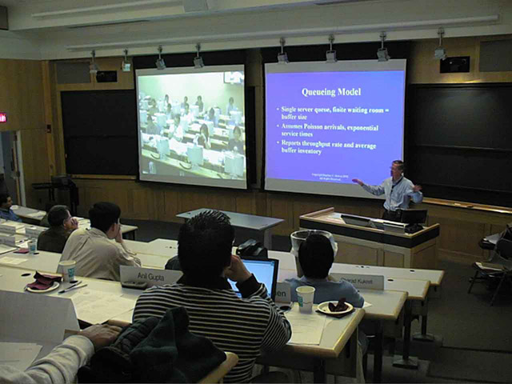
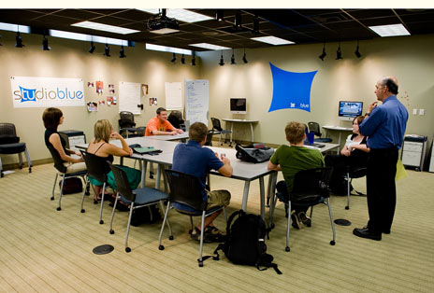
Physical Spaces
introduction
Describe a few formal classroom setting
physical
virtual
blended
conclusion

Slide 5
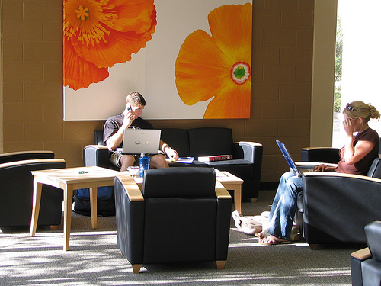
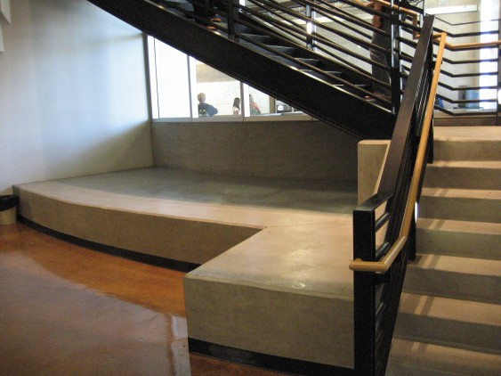
Physical Spaces
introduction
Describe a few informal classroom settings
physical
virtual
blended
conclusion

Slide 6
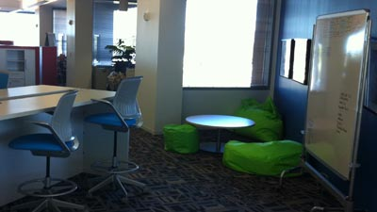
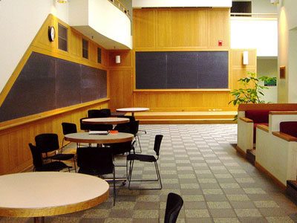
Physical Spaces
introduction
Describe a few informal classroom settings
physical
virtual
blended
conclusion

Slide 7
Physical Spaces
introduction
Best Practices in Learning Space Design: Engage Users (by Phyllis Grummon)
Students take pictures of space and describe why it is conductive to learning
physical
Visit the space throughout the day to observe the number of people and how it is being used
Spend time in a public space observing how it is being used
virtual
Gather information via Twitter and Facebook on how space in used
blended
Findings – Flexibility is the key
conclusion

Slide 8
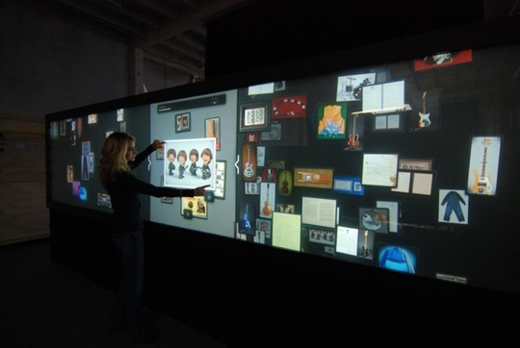
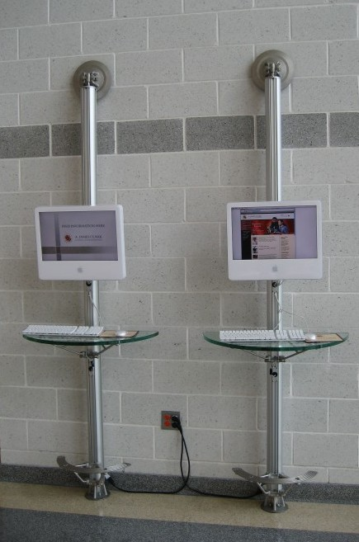
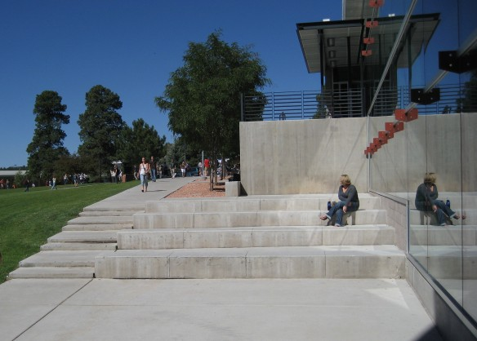
Physical Spaces
introduction
Informal Spaces
physical
Public
Access
Terminals
Display Screens and Kiosks
virtual
blended
Transition Spaces
Indoor/
Outdoor Spaces
conclusion

Slide 9
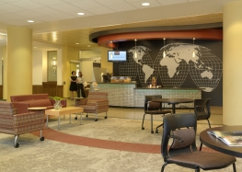
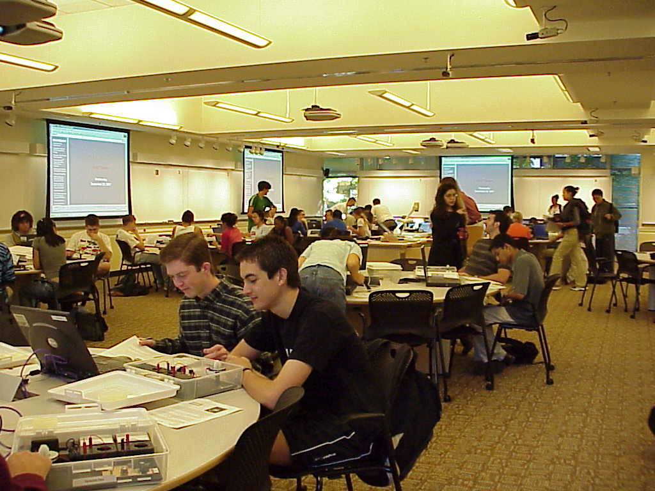
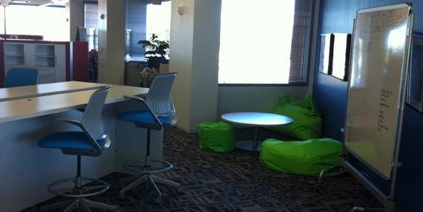
Physical Spaces
introduction
Informal Spaces
physical
Dining Spaces
virtual
Collaborative Spaces
blended
Multipurpose Spaces
conclusion

Slide 10
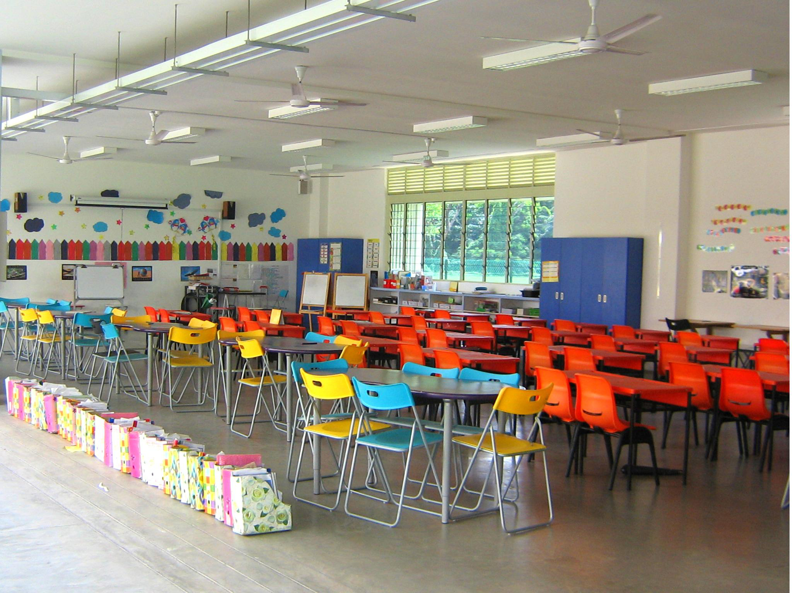
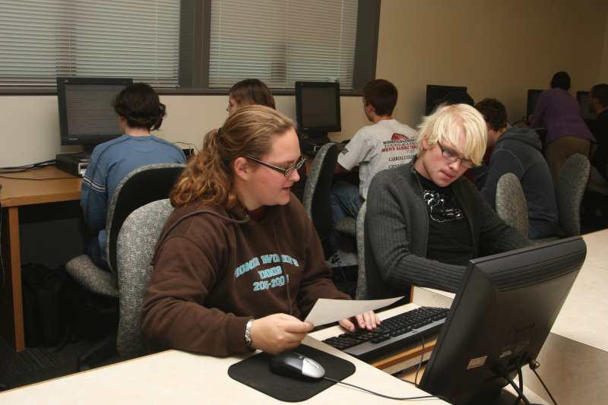

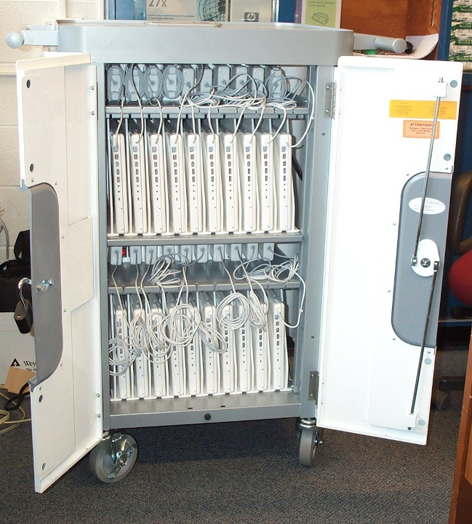
Physical Spaces
introduction
Formal Spaces
physical
Traditional Classroom
virtual
Teaching Labs
blended
Open Labs
Mobile Computer Labs
conclusion

Slide 11
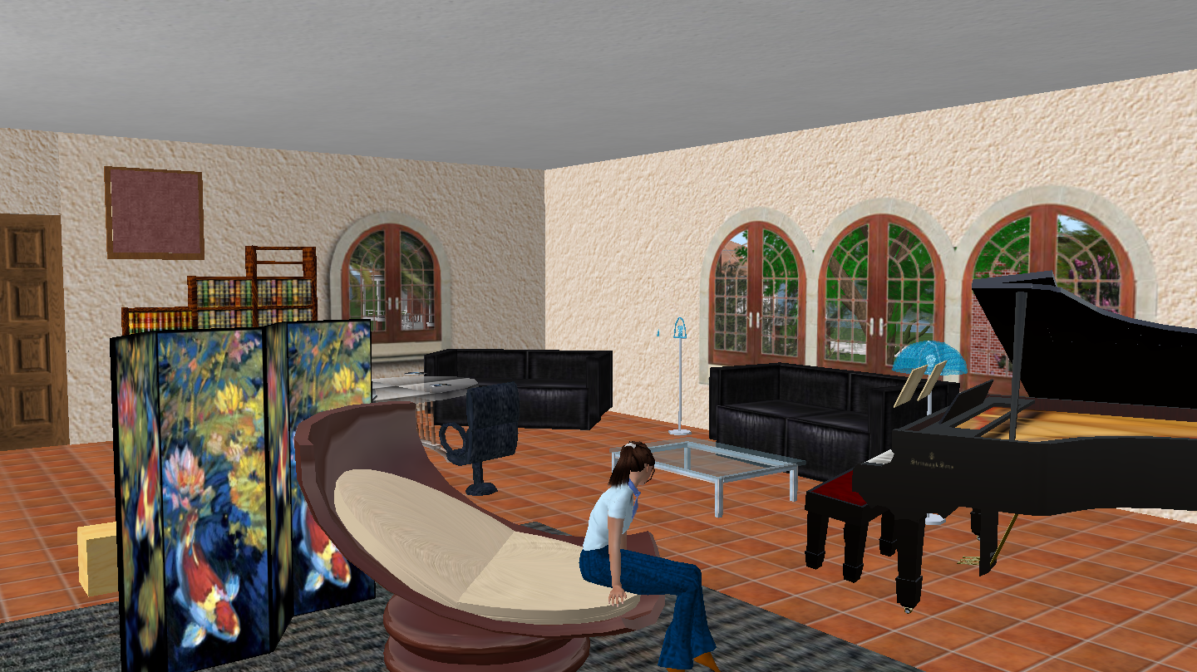
Virtual Spaces
introduction
Includes:
Online Courses
Virtual Worlds
Social Networking
Synchronous/Asynchronous Meetings
Web 2.0 Tools
physical
Culturally Pluralistic – insure that the space takes into account cognitive, social and pedagogical issues.
virtual
Henderson states that no design of a learning environment can be culturally neutral.
He sees the following approaches:
  Inclusive or perspective approach
  Inverted curriculum approach
  Culturally one-dimensional approach
blended
conclusion

Slide 12
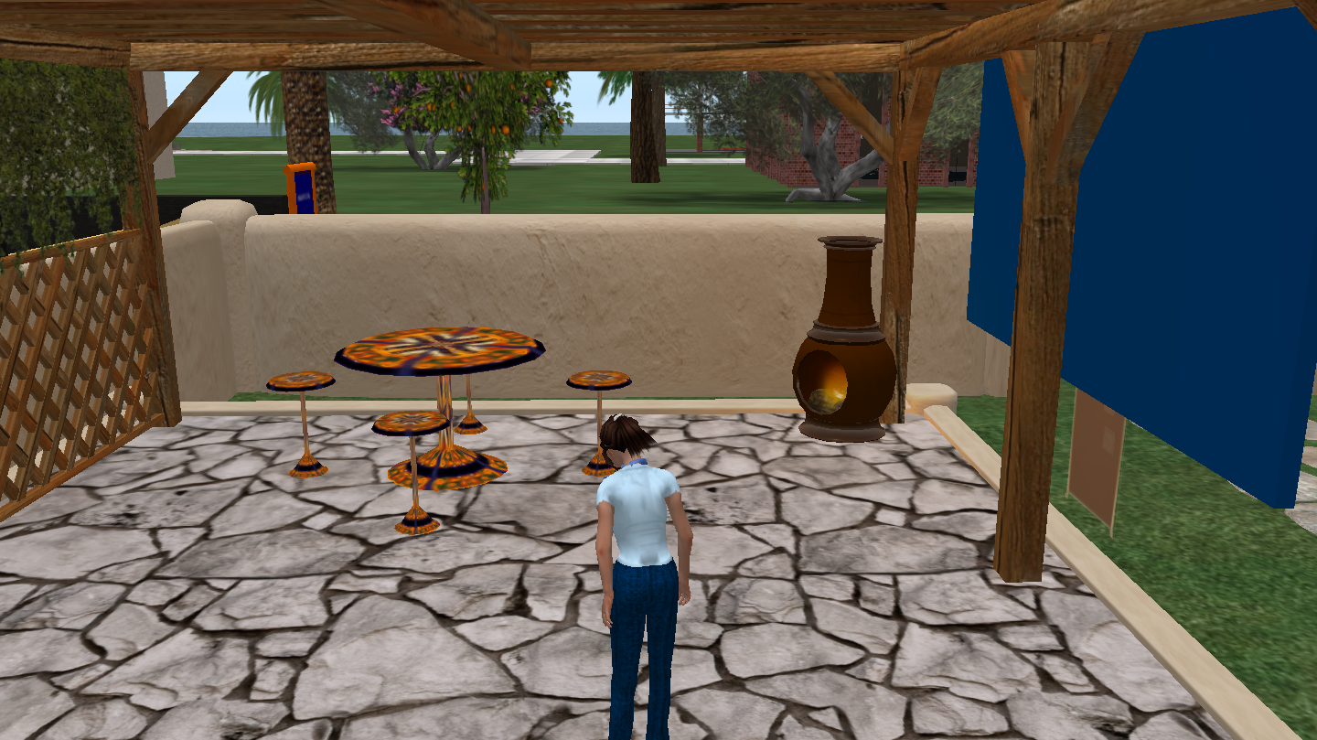
Virtual Spaces
introduction
L. Henderson (1994) states that no design of a learning environment can be culturally neutral.
physical
He sees the following approaches:
  Inclusive or perspective approach
  Inverted curriculum approach
  Culturally one-dimensional approach
virtual
He proposes these solutions:
Reflect upon the multicultural realities of society
Include multiple cultural ways of learning and teaching
Promote equity of learning outcomes
blended
conclusion

Slide 13
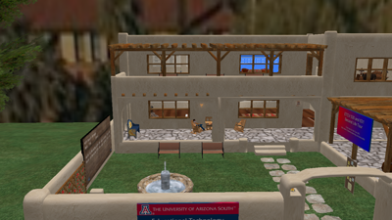
Virtual Spaces
introduction
McLoughlin and Oliver, two Australia researcher developed ten design principles for creating a culturally inclusive online learning environment.
physical
1. Support constructivist learning from multiple perspectives.
2. Design authentic learning activities.
3. Created flexible task and tools for sharing knowledge.
virtual
4. Ensure different forms of support.
5. Establish flexible and responsive student roles and responsibility.
6. Provide communication tools for social interaction.
blended
7. Create task for self-direction, ownership and collaboration.
8. Ensure flexible tutoring and mentoring.
9. Create varied resources for multiple perspectives.
10. Provide flexibility in goals, outcomes and modes of testing.
conclusion

Slide 14
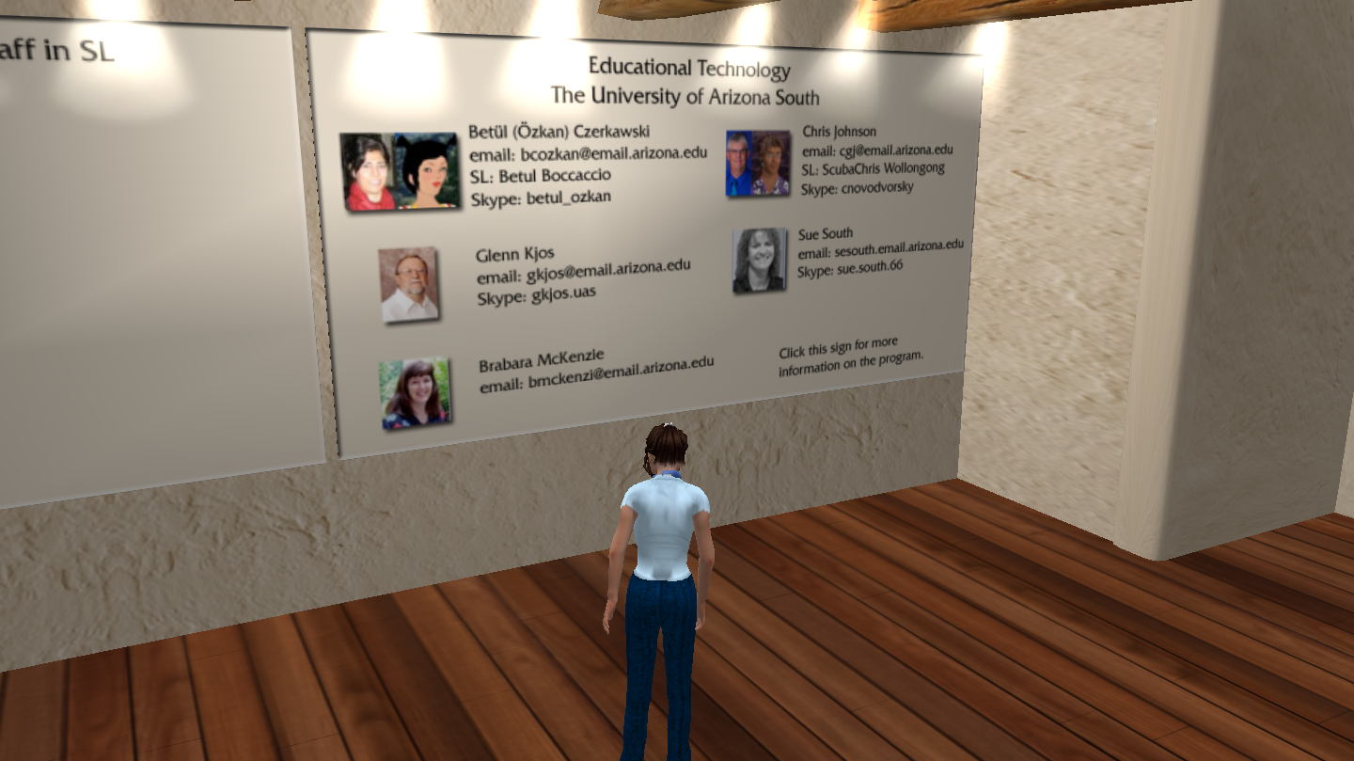
Virtual Spaces
introduction
Hypermedia Open Center (Europe)
Created a 3D learning environment
physical
Used in 20 countries
Four projects:
1) Virtual Leonardo
2) Dead Sea Scrolls
3) Medieval History of Lombardy, Italy
4) Social Value of Sports
virtual
Findings:
1) Create a well structured format
2) Use high quality culturally challenging content
3) Allow students to share and compare
4) Constant support and monitoring of the environment
blended
conclusion

Slide 15
Blended Spaces
introduction
Bring together the best of both worlds!
physical
Physical
virtual
blended
Virtual
conclusion

Slide 16
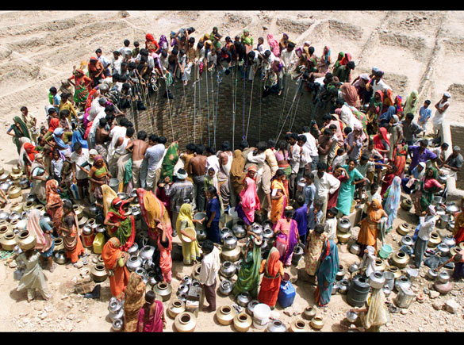
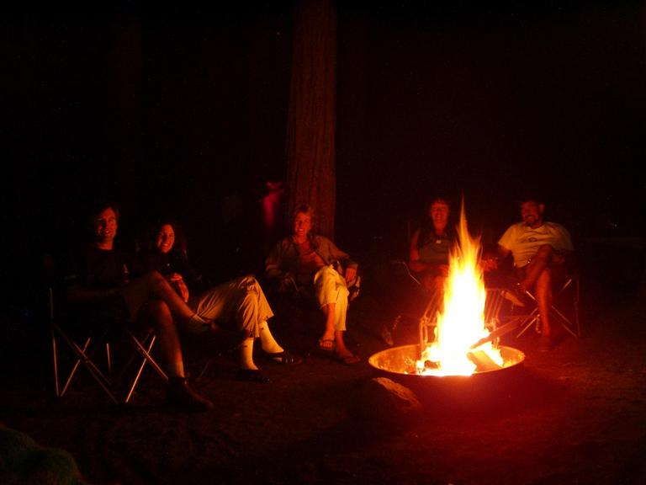
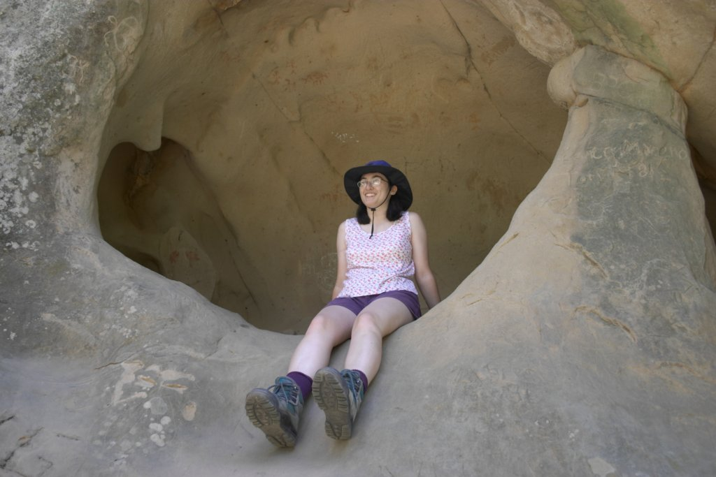
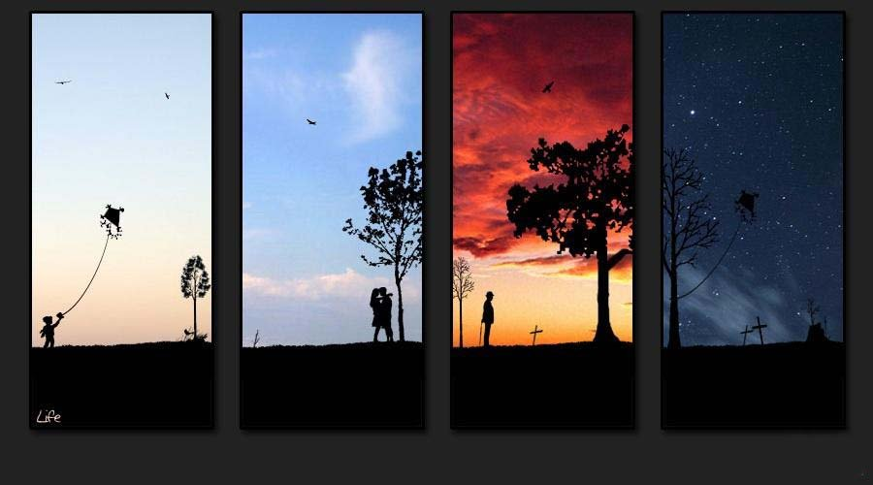
Blended Spaces
introduction
Thornburg’s Primordial Metaphor
The Campfire…
physical
The Watering Hole…
virtual
blended
The Cave…
conclusion
LIFE…

Slide 17
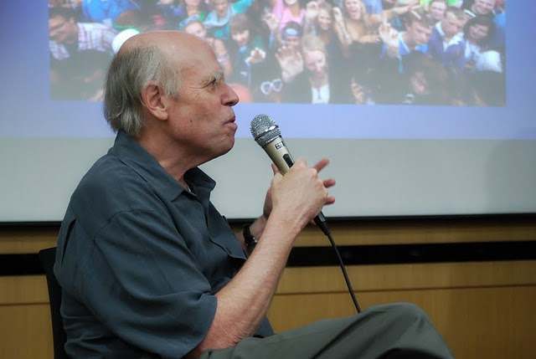
Blended Spaces
introduction
James Gee
Good Video Games,
Good Learning (2007)
physical
virtual
blended
conclusion

Slide 18
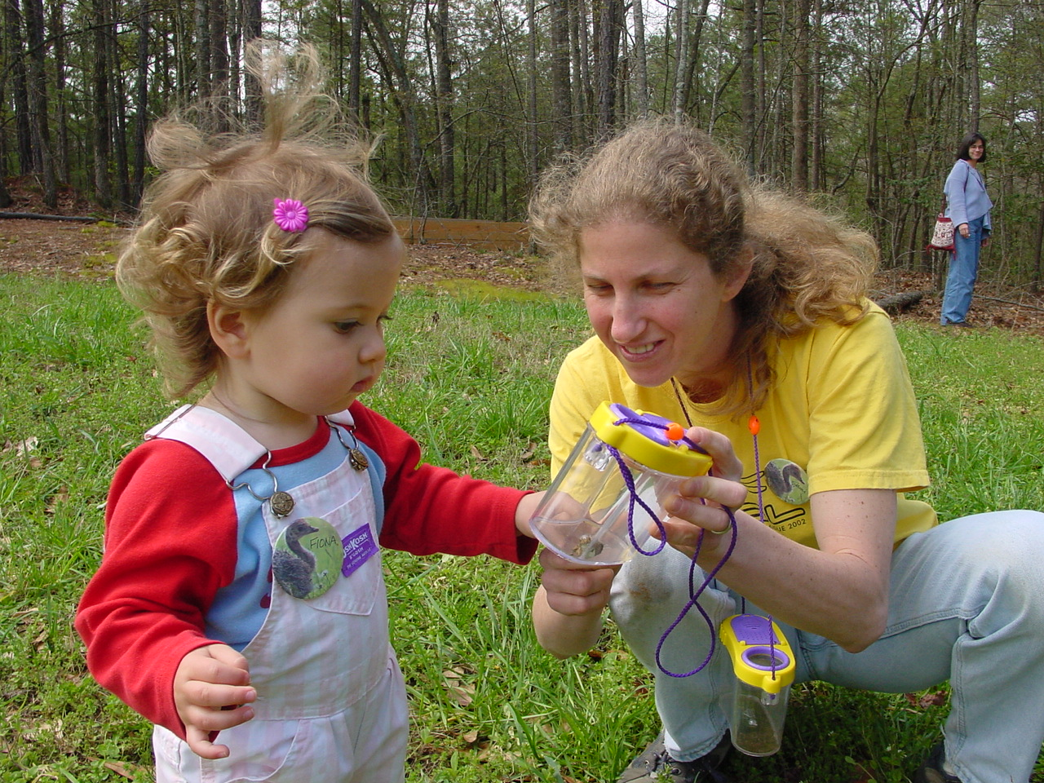
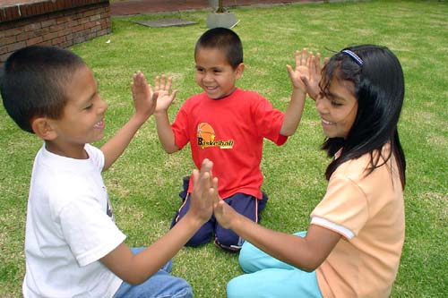
Conclusion
introduction
The Third Teacher
by Loris Malaguzzi
First Teacher…
physical
Second Teacher…
virtual
Third Teacher…
blended
conclusion

