Slide 1
A Quality Matters “Quickie”
An Introduction to Quality Matters

Slide 2
Questions to ponder for this session
Why is it necessary to provide an introduction to QM?
How can we introduce QM to our faculty and staff?
What are some effective methods to entice them to “buy in” to QM?
What are other institutions doing to introduce QM to their campus?
Our answer is the “QM Quickie Presentation”

Slide 3
When discussing online courses, who does quality matter to…
S_______
F_______
A_______
U_______
A________ A_____
L_________
T____-P____

Slide 4
When discussing online courses, who does quality matter to…
Students
Faculty
Administrators
University Brand
Accrediting Agencies
Legislators
Tax-Payers

Slide 5
Why do we want quality online courses?
Improve student learning outcomes
Improve student retention
Prevent cheating
Promote interest in the content
Promote lifelong learning

Slide 6
When it comes to online courses, how do we…
Define quality?
Assess quality?
Measure quality?
Evaluate quality?
Notes:
Assessment is the collection of data to better understand what has been learned.
Measurement is the process of quantifying the assessment data
Evaluation is the comparison of the data to a standard

Slide 7
What is Quality Matters (QM)?
It is a faculty-centered, peer review process designed to certify the quality of online courses and online components
It uses a set of tools (standards) for designing and reviewing online and blended courses
It is:
Continuous – quality improvement process
Centered – research, student learning and quality
Collegial – faculty driven
Collaborative – review is conducted among peers

Slide 8
What Quality Matters is NOT
It is NOT:
About individual instructors (it is about the course design)
About faculty evaluation (it is about course quality)
A pass/fail test (it is a diagnostic tool)
About creating the “perfect” course (create an effective course, better than average – 85%)

Slide 9
The Origins of Quality Matters
Began as a Fund for the Improvement of Postsecondary Education (FIPSE) grant project in 2003.
Why: The project was to develop an instrument and process through which a quality online course could be recognized by a community of peers in online learning.
How: The project was research-based, collaborative and peer-centered.
Results: The project outcome was a rubric tool and a process for applying the rubric in peer reviews of online courses.

Slide 10
Subscription to Quality Matters
University of Arizona has a state wide subscription($1,000)
The subscription entitles us to:
Access to the Quality Matters Rubric
Discount on Professional Development
Participation in the QM User Group
License to conduct QM Applying the Rubric Workshop
Licensed to conduct official course reviews eligible for QM recognition

Slide 11
Did someone say Professional Development (aka. “training” )?
Yes – some of the online professional development courses offered are:
Applying the QM Rubric
QM Peer Reviewer Certification
Improving Your Online Course
Designing Your Online Course
Designing Your Blended Course
How much?
Time – Two week sessions
Cost - $150 - $200
https://www.qualitymatters.org/professional-development/courses

Slide 12
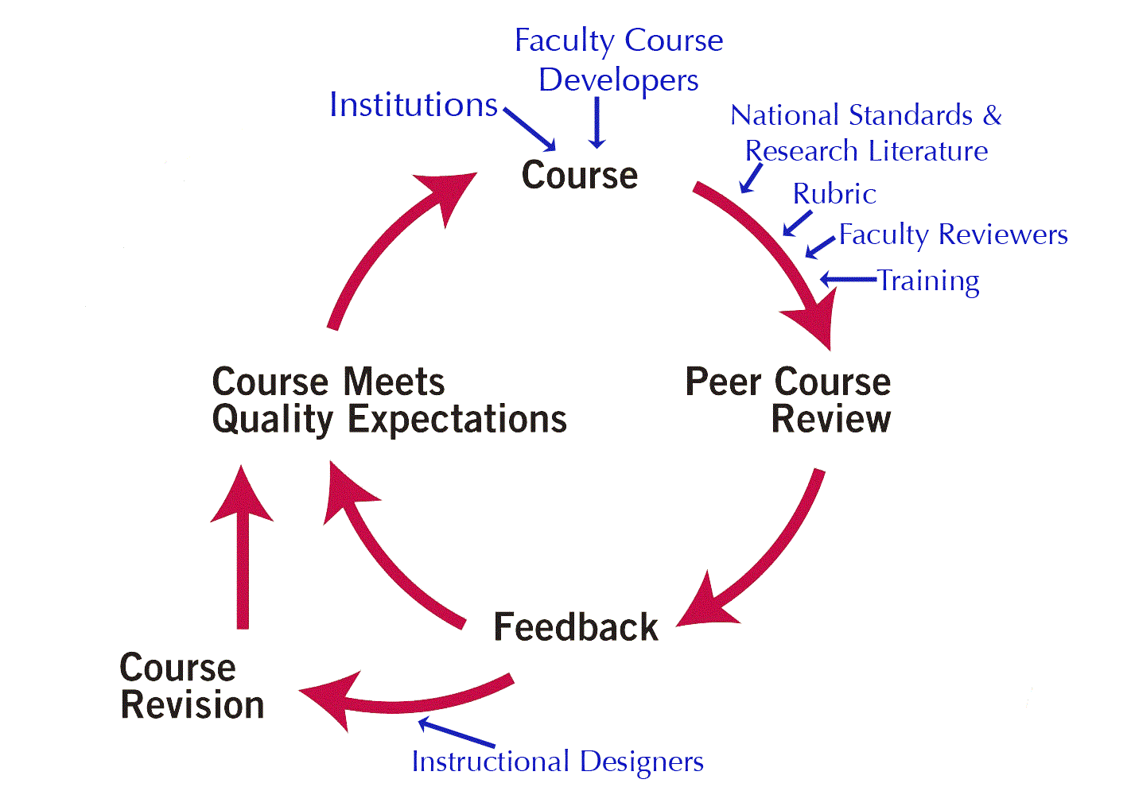
The Process
Notes:
This diagram illustrates the focus on continuous improvement and summarizes the Quality Matters course review process:
COURSE: Beginning at the top of the cycle, institutions decide to examine an online or hybrid course as part of a peer review. The institution may submit its course to QM for a formal review or, if the institution is a QM subscriber, it may conduct the formal course review in-house (both a formal QM review and a formal in-house process lead to QM recognition). The institution may also decide to use the rubric informally and do a review using its own process (this informal process does not lead to QM recognition).
PEER COURSE REVIEW: The course is then reviewed by a team of three peer reviewers using the QM Rubric. The QM rubric is based in national standards of best practice, the research literature, and instructional design principles. Peer reviewers must have online teaching experience and complete the Peer Reviewer Training to be eligible to serve on a formal QM review. The peer review team consists of at least one member from an institution other than the course’s home institution. The team also consists of one member from a discipline that matches that of the course. This combination of reviewers ensures a diverse set of perspectives.
FEEDBACK: Following the course review, the review team’s feedback is provided to the faculty member or team that developed the course. The feedback consists of two components:
Scoring - indicates which QM standards were and were not met by the course.
Feedback - a rich set of comments from the reviewers indicating the strengths of the course, areas for improvement and specific recommendations and suggestions for improving the course. Upon initial review, the course may or may not have met Quality Expectations. In either case, the QM review provides support for course revisions and improvement. If a course did not initially meet Quality Expectations, the team chair will re-review the course after revisions.
MEETS QUALITY EXPECTATIONS: QM expects that all courses will work toward and achieve quality expectations. The QM review process is not meant to be a test in which a course passes or fails. The overall goal is to provide a system for the improvement of course quality, rather than the simple assignment of a grade or quality level to the initial course.

Slide 13
Factors Reviewed in the Process
Reviewed:
Course Design
Not Reviewed:
Course Delivery (faculty performance)
Course Content
Course Management System
University Infrastructure
Faculty Training and Readiness
Student Engagement and Readiness

Slide 14
The Purpose of the Quality Review
Must score more than average; more than “good enough” (85%)
Must make an attempt to capture what is expected in an effective online course
The score is based upon the QM Rubric which is based on research and widely accepted standards

Slide 15
The Rubric
Eight General Standards
Overall design of the course is clear
Learning objectives are clearly stated and explained
Assessment strategies and measure are well integrated
Instructional materials and resources are sufficiently comprehensive
Meaningful interaction in the course
Navigation and technology are intuitive
Support provided for student success
Accessibility (UDL standards)

Slide 16
COURSE OVERVIEW & INTRODUCTION
The overall design of the course is made clear to the learner at the beginning of the course.
Instructions make clear how to get started and where to find various course components. IDEAS? _______________________
Learners are introduced to the purpose and structure of the course. IDEAS? ________________________
Notes:
The overall design of the course is made clear to the learner at the beginning of the course.

Slide 17
LEARNING OBJECTIVES (COMPETENCIES)
Learning objectives or competencies describe what learners will be able to do upon completion of the course.
The course learning objectives or course/program competencies, describe outcomes that are measurable.
All learning objectives or competencies are stated clearly and written from the learner’s perspective.
HOW DO YOU DO THIS? ___________

Slide 18
ASSESSMENT AND MEASUREMENT
Assessments are integral to the learning process and are designed to evaluate learner progress in achieving the stated learning objectives or mastering the competencies.
The assessments measure the stated learning objectives or competencies.
Specific and descriptive criteria are provided for the evaluation of learners’ work and are tied to the course grading policy.
IDEAS? _______________________

Slide 19
INSTRUCTIONAL MATERIALS
Instructional materials enable learners to achieve stated learning objectives or competencies.
The instructional materials contribute to the achievement of the stated course and module/unit learning objectives or competencies.
Both the purpose of instructional materials and how the materials are to be used for learning activities are clearly explained.
IDEAS? _______________________

Slide 20
Course Activities and Learner Interaction
Course activities facilitate and support learner interaction and engagement.
The learning activities promote the achievement of the stated learning objectives or competencies.
Learning activities provide opportunities for interaction that support active learning.
The instructor’s plan for classroom response time and feedback on assignments is clearly stated.
IDEAS? _______________________

Slide 21
COURSE TECHNOLOGY
Course technologies support learners’ achievement of course objectives or competencies.
The tools used in the course support the learning objectives or competencies.
Course tools promote learner engagement and active learning.
IDEAS? _______________________

Slide 22
LEARNER SUPPORT
The course facilitates learner access to institutional support services essential to learner success.
The course instructions articulate or link to a clear description of the technical support offered and how to access it.
Course instructions articulate or link to the institution’s accessibility policies and services.
IDEAS? _______________________

Slide 23
ACCESSIBILITY and USABILITY
The course design reflects a commitment to accessibility and usability for all learners.
Course navigation facilitates ease of use.
Information is provided about the accessibility of all technologies required in the course.
IDEAS? _______________________

Slide 24
Underlying Principles of QM
Based on national standards of best practices, research literature and instructional design principles.
Not to create the “perfect” course, but better than “good enough” (85%)
A continuous quality improvement process involving the faculty to successfully meeting expectation
Faculty driven, peer review process, not an evaluation
Promote student learning

Slide 25
Interested in Quality Matter?
LATTe (Learning and Teaching with Technology) Group
There is a special interest group (SIG) on Quality Matters
Statewide network
Contact:
Melody Buckner at mbuckner@arizona.edu
Chris Johnson at cgj@email.arizona.edu
Website: http://www.qmprogram.org

